Slide 1
Introduction to Transactions

Slide 2
Purpose of Transactions
Ensure that objects managed by a server remain consistent even when accessed by multiple clients or during server crashes.
Transactions guarantee atomicity—either all operations complete successfully (commit) or none take effect (abort).

Slide 3
Recoverable Objects
Objects must be recoverable after server failures. Servers use persistent storage (e.g., disks) to save state information for recovery.
Example: A banking server storing account balances must recover to a valid state after a crash.

Slide 4
Concurrency Control
Prevents interference between concurrent client operations. Without proper control, issues like lost updates or inconsistent retrievals can arise.
Example: Two clients transferring funds concurrently must not overwrite each other’s changes.

Slide 5
ACID Properties
Atomicity: All operations in a transaction succeed or fail together.
Consistency: Transactions move the system from one valid state to another (programmer’s responsibility).
Isolation: Concurrent transactions do not interfere.
Durability: Committed changes survive failures.

Slide 6
Example: Banking System
Operations: deposit, withdraw, getBalance, create, lookUp, branchTotal.
Atomicity: If a transfer (e.g., $100 from Account A to B) is interrupted, the transaction aborts, leaving balances unchanged.
Concurrency Issues: Without locks, simultaneous transfers might corrupt balances

Slide 7
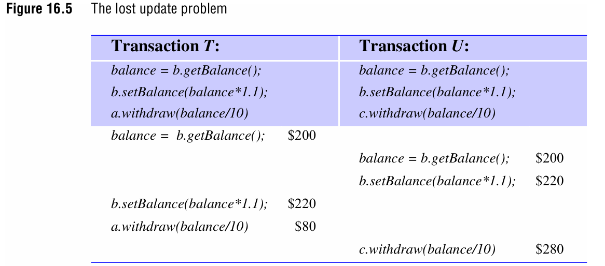

Slide 8
Transaction Management
Coordinator Interface :
openTransaction(): Starts a transaction, returns a unique ID (TID).
closeTransaction(): Ends a transaction (commit/abort).
abortTransaction(): Explicitly aborts a transaction.

Slide 9
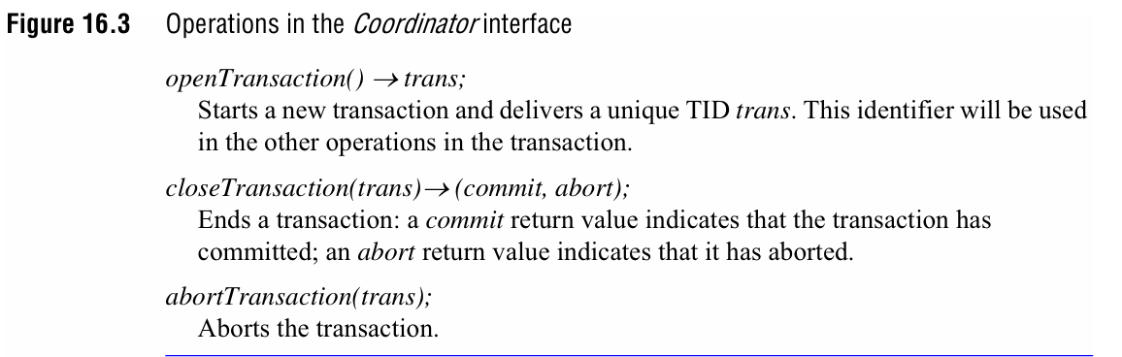

Slide 10
Transaction Management
Recovery:
Servers log transactions to persistent storage. During recovery, logs rebuild the last consistent state.
Example: If a server crashes mid-transaction, it uses logs to undo incomplete changes.

Slide 11
Why Transaction Matters
Atomicity ensures no partial updates (e.g., money deducted but not credited).
Isolation prevents clients from seeing intermediate, inconsistent states.
Durability guarantees that committed transactions persist even after crashes.

